Slide 1
Tutorial 02: Stack and Queue
CSCI2520 - Data Structures and Applications
Tutor: Zheng chenguang

Slide 2
Outlines
1. Exercises about C
2. Abstract Data Type (ADT)
3. Stack
4. Queue
5. Exercise

Slide 3
Exercise 1
What is the output?
#include <stdio.h>
int main() {
int firstvalue = 5, secondvalue = 15;
int *p1, *p2;
p1 = &firstvalue;
p2 = &secondvalue;
*p1 = 10;
*p2 = *p1;
p1 = p2;
*p1 = 20;
printf("first value is %d\n", firstvalue);
printf("second value is %d\n", secondvalue);
return 0;
}

Slide 4

Exercise 1 Solution
What is the output?
#include <stdio.h>
int main() {
int firstvalue = 5, secondvalue = 15;
int *p1, *p2;
p1 = &firstvalue; // p1 = address of firstvalue
p2 = &secondvalue; // p2 = address of secondvalue
*p1 = 10; // value pointed to by p1 = 10
*p2 = *p1; // value pointed to by p2 = value pointed to by p1
p1 = p2; // p1 = p2 (value of pointer is copied)
*p1 = 20; // value pointed to by p1 = 20
printf("first value is %d\n", firstvalue);
printf("second value is %d\n", secondvalue);
return 0;
}

Slide 5
Exercise 2
What is the output?
10, 20, 30, 40, 50,
#include <stdio.h>
int main() {
int numbers[5];
int * p;
p = numbers; *p = 10;
p++; *p = 20;
p = &numbers[2]; *p = 30;
p = numbers + 3; *p = 40;
p = numbers; *(p + 4) = 50;
for (int n = 0; n<5; n++)
printf("%d, ", numbers[n]);
return 0;
}

Slide 6
Exercise 3.1
What is the output?
#include <stdio.h> /* printf */
void exchange(int a, int b) {
int temp = a;
a = b;
b = temp;
}
void main() {
int a = 3, b = 7;
printf("Before exchanging: a=%d, b=%d\n", a, b);
exchange(a, b);
printf("After exchanging: a=%d, b=%d\n", a, b);
}

Slide 7
Exercise 3.2
What is the output?
#include <stdio.h> /* printf */
void exchange(int *a, int *b) {
int temp = *a;
*a = *b;
*b = temp;
}
void main() {
int a = 3, b = 7;
printf("Before exchanging: a=%d, b=%d\n", a, b);
exchange(&a, &b);
printf("After exchanging: a=%d, b=%d\n", a, b);
}

Slide 8
Exercise 3.3
What is the output?
#include <stdio.h> /* printf */
void exchange(int *a, int *b) {
int* temp = a;
a = b;
b = temp;
}
void main() {
int a = 3, b = 7;
printf("Before exchanging: a=%d, b=%d\n", a, b);
exchange(&a, &b);
printf("After exchanging: a=%d, b=%d\n", a, b);
}

Slide 9
Exercise 4
What is the difference?
typedef struct Student_Data Sdata;
typedef struct Student_Data *SdataPtr;
struct Student_Data {
char name[50];
int age;
};
int main() {
Sdata *p;
SdataPtr p2;
p = (Sdata*)malloc(sizeof(Sdata));
p2 = (SdataPtr)malloc(sizeof(Sdata));
p->age = 10; // equals (*p).age = 10;
}

Slide 10
Abstract Data Type (ADT)
Data Type is
a set of values, associated with
a set of operations applied on these values
Data abstraction is the separation between the specification of a data object and its implementation
Data Encapsulation or Information Hiding is the concealing of the implementation of a data object from the outside world
ADT is a Data Type, uses the idea Data Abstraction, and helps Data Encapsulation

Slide 11
Abstract Data Type (ADT)
We already have
rationalADT
stackADT
queueADT
For an ADT, we have
ADT definition/specification
ADT implementation
ADT Application Program
Question: why ADT?

Slide 12
Why ADT?
rational.h
typedef struct rationalCDT *rationalADT;
rationalADT r_read();
rationalADT r_add(rationalADT x, rationalADT y); // ⊕
rationalADT r_minus(rationalADT x, rationalADT y); // ⊖
rationalADT r_mult(rationalADT x, rationalADT y); // ⊗
rationalADT r_div(rationalADT x, rationalADT y); // ⊘
rationalADT r_num(int p, int q); // ^{p}/_{q}
void r_print(rationalADT x);
rationalADT r_simplify(rationalADT x);
Again, users do not need to know the content of rational.c.
ADT Definition/Specification
(No Change!)
rational.c (Implementation 2)
#include "rational.h"
struct rationalCDT { // Implementation 2
int arr[2]; // rational num = arr[0]/arr[1]
};
rationalADT r_num(int a, int b) {
rationalADT x;
x = (rationalADT)malloc(sizeof(*x));
x->arr[0] = a;
x->arr[1] = b;
return x;
}
…… // other functions
calculate.c
#include "rational.h"
int main() {
rationalADT x, y, t, result;
x = r_read(); // read rational number x
y = r_read(); // read rational number y
result = r_add(x, y); // x ⊕ y
t = r_num(6, 7); // ⁶/₇
result = r_mult(result, t); // (x ⊕ y) ⊗ ⁶/₇
r_print(result);
return 0;
}
ADT Implementation
(Changed)
ADT Application Program
(No Change!)

Slide 13
Why ADT?
Hiding the implementation of an ADT from the user means there are fewer details for the user to understand.
A programmer who implements an ADT is flexible to change its underlying representation.
An ADT interface acts as a wall that protects the implementation and the user from each other.

Slide 14
Stack
An ordered list in which all insertions and deletions are made at the top
LIFO – Last In First Out
Fundamental operations include:
Push() – insert
Pop() – delete most recently inserted one
More operations
EmptyStack() – return a new empty stack to the user
StackDepth() – return the size of the stack
StackIsEmpty() – return true if the stack is empty

Slide 15
Stack
Ways to implement
fixed-sized array (Ver 1.0)
dynamic array (Ver 2.0)
Question: what is the difference between the two?
struct stackCDT {
stackElementT elements[100];
int count;
};
struct stackCDT {
stackElementT *elements;
int count;
int size;
};
Notes:
array-index-out-of bounds errors (stack overflow).
Realloc()

Slide 16
Queue
An ordered list in which all insertions take place at the tail, while all deletions take place at the head
FIFO – First In First Out
Fundamental operations include:
Enqueue() – insert an element at the tail
Dequeue() – return and delete the element at the head
More operations
EmptyQueue() – return a new empty queue to the user
QueueLength() – return the number of elements
QueueIsEmpty() – return true if the queue is empty

Slide 17
Queue
Ways to implement
fixed-sized array
dynamic array
linked list
typedef struct cellT {
queueElementT element;
struct cellT *next;
} cellT;
struct queueCDT {
cellT *head;
cellT *tail;
};
struct queueCDT {
queueElementT elements[100];
int head;
int tail;
}
struct queueCDT {
queueElementT *elements;
int head;
int tail;
int size;
}

Slide 18
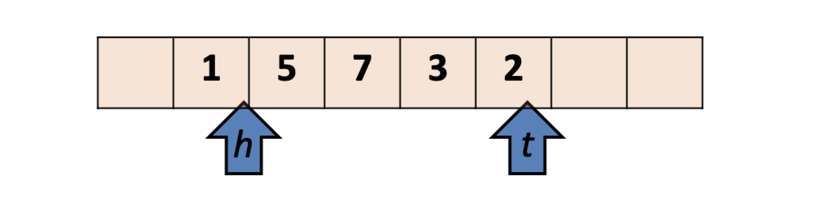
Queue Implementation V1.0
Implement the queue with array
Question: what if we enqueue and dequeue for many (e.g. millions of) times?

Slide 19
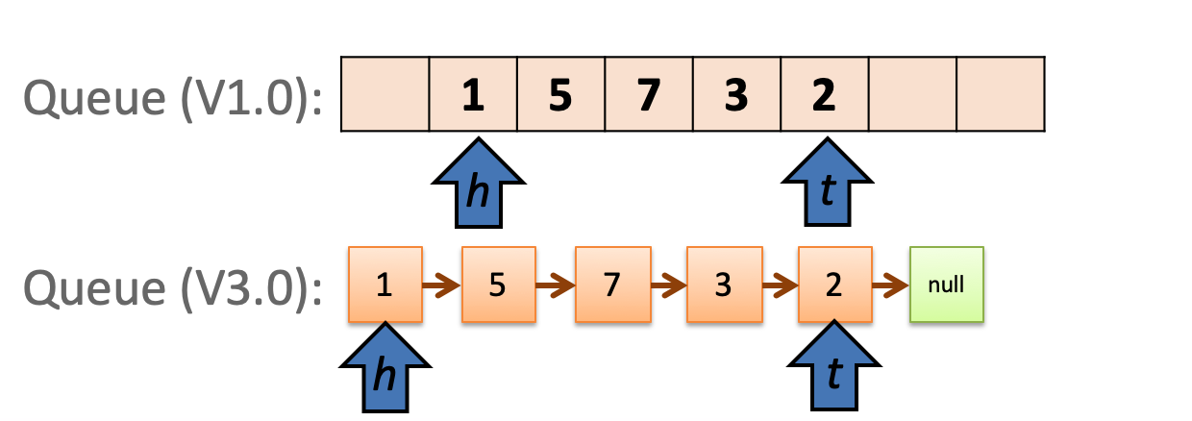
Queue Implementation V3.0
Implement the queue with linked list
Use pointers
What is the advantage of V3.0?

Slide 20
Exercise
Extend the Queue V1.0 to Circular Queue with the following specification.
typedef struct queueCDT *queueADT;
typedef int queueElementT;
struct queueCDT {
queueElementT elements[10];
int head;
int tail;
};
queueADT EmptyQueue();
void Enqueue(queueADT queue, queueElementT element);
queueElementT Dequeue(queueADT queue);
int QueueLength(queueADT queue);
int QueueIsEmpty(queueADT queue);

Slide 21
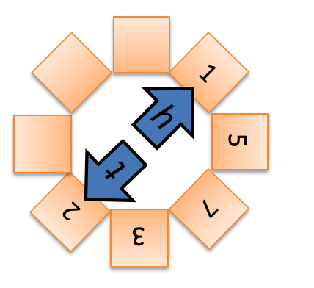
Exercise
Circular Queue: Wrap around front and rear whenever it gets to the end of the array
Hint: Use the modulus operator (%)
Queue V1.0:
Circular Queue:

Slide 22
Exercise Solution
queueADT EmptyQueue(){
queueADT queue;
queue = (queueADT)malloc(sizeof(struct queueCDT));
queue->head = 0;
queue->tail = 0;
return queue;
}
void Enqueue(queueADT queue, queueElementT element){
queue->elements[queue->tail] = element;
queue->tail = (queue->tail + 1) % 10;
}

Slide 23
Exercise Solution
queueElementT Dequeue(queueADT queue){
queueElementT returnValue = queue->elements[queue->head];
queue->head = (queue->head + 1) % 10;
return returnValue;
}
int QueueLength(queueADT queue){
return (queue->tail - queue->head + 10) % 10;
}
int QueueIsEmpty(queueADT queue){
return (queue->tail == queue->head);
}

Slide 24
Exercise Solution
void main(){
queueADT myQueue = EmptyQueue();
Enqueue(myQueue, 1);
Enqueue(myQueue, 2);
Enqueue(myQueue, 3);
Enqueue(myQueue, 4);
Enqueue(myQueue, 5);
Enqueue(myQueue, 6);
for (int num = 7; num <= 12; ++num){
Enqueue(myQueue, num);
printf("Enqueue %d, length becomes %d\n", num, QueueLength(myQueue));
int ret = Dequeue(myQueue);
printf("Dequeue and get %d, length becomes %d\n", ret, QueueLength(myQueue));
}
}

Slide 25
Q&A

